Slide 1

Cognitive Behavioral Therapy
Presented by (student’s name)

Slide 2
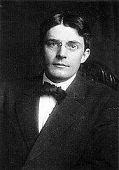
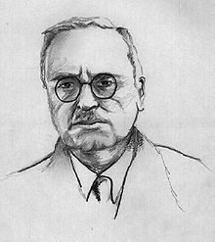
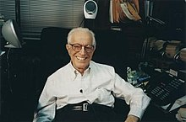
Introduction
CBT as it is known and used today has its roots in the behavior therapy which developed in the 20th century and the cognitive therapy developed in the 1960s, and the alignment and merger of the two therapeutic approaches (Rothbaum et al 2000)
John B. Watson and Rosalie Rayner’s behaviorism studies are the earliest predecessors of CBT and helped shape the practice.
CBT gained popularity among therapist in the 1950s and 1960s, and was modified and used all around the world.
Alfred Adler was among the first therapists to study cognition in psychotherapy.
Alder’s work shaped Albert Ellis’ work, who fine-tuned the earliest CBT approaches known today as rational emotive behavior therapy.
John B. Watson
Alfred Adler
Albert Ellis
Notes:
CBT, as used by therapists today, can be traced to the 20th century behavioral therapy and later cognitive therapy. In 1920, therapists John Watson and Rosalie began researching conditioning and behavior therapy. By the 1950s and 60s, therapists and researchers in America, Europe, and South Africa started expressing interest in behavioral therapy, which was influenced by the prior studies by John B. Watson, Ivan Pavlov, and Clark Hull. Other notable therapists, including Hans Eysenck of Britain, also adopted behavioral therapy as an alternative result-oriented therapy. Alfred Adler first proposed cognitive therapy, which forms an integral part of CBT. Adler made a research breakthrough with his observation about basic mistakes and how they led people to develop unhealthy and unhelpful behaviors and goals. Several therapists borrowed from Adler’s work to create a new therapy approach. Albert Ellis, who builds on Adler’s work, developed one of the earliest forms of CBT, the Rational Emotive Behavior Therapy (REBT), which other therapists used to create the modern forms of CBT.

Slide 3
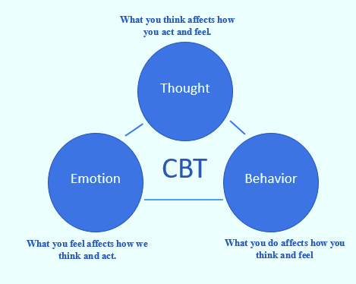
Major CBT Concepts
CBT aims to help couples address their problems through challenging and fixing cognitive problems such as beliefs, thoughts and behaviors.
CBT acknowledges that, a person’s thoughts, behaviors and emotions are all interconnected and ultimately affect how a person reacts to problems (Bjorgvinsson 2006)
CBT also acknowledges that, a person has to acknowledge and address their internal conflicts which influences how couples react and address the problems which drive them to therapy.
Notes:
CBT is based on the idea that an individual's dysfunctional thinking may be traced back to erroneous internal processes, often known as systemic biases. CBT combines elements of cognitive therapy's cognitive restructuring approach with behavioral therapy's behavioral modification approaches in order to create a therapeutic structure that can discover irrational and maladaptive thoughts, assumptions, and basic beliefs about a person's condition. In theory, mental health problems or dichotomous thinking, overgeneralization, labeling and mislabeling, magnification vs minimization, selective abstraction, arbitrary interference, personalizing, and mind-reading are all mental health disorders caused by system bias cognition.
CBT practices follow six phases which are determined by the three concepts captured above. The process begins with psychological assessment, reconceptualization, acquisition of skills, consolidating skills, generalization and finally post treatment evaluation and follow up of the treatment outcomes.

Slide 4

Interventions used in CBT
CBT is a result-oriented therapeutic approach that helps clients change their thoughts, feelings and overall behavior as a wat of addressing their problems and challenges (Neenan, 2008)
Some of the common interventive approaches include:
Realistic thinking
Self-instruction training
Problem solving
Notes:
CBT often follows a problem-focused approach alongside result-oriented therapy strategies established on the concept that a person can resolve their harmful traits and behaviors through rationalization of one's thoughts. Essentially, CBT helps couples and families solve their problems through addressing the individual partner's issues that contribute to the overall issues.
CBT interventive approaches use cognitive elements that are premised on the understanding that an individual's thoughts and behaviors about a specific situation influence their feelings and reactions to problems. Three of the most commonly used interventive approaches are discussed below.
Realistic thinking- the therapist continuously engages with the clients and put them through artificial stressful situations. The therapists then motivate the clients to solve these fictional problems. In so doing, the clients understand the difference between reality and the cognitive tensions raised by their feelings and emotions.
Self-instruction training- using this interventive approach, the therapist helps the clients develop relevant stress coping skills to help them navigate the problems that led them into therapy.
Problem-solving- the counsellor helps the clients logically assess the faulty conditions that contribute to their problems and logically respond to break the behavioral patterns that facilitate the issues.

Slide 5
CBT coping skills
There are several techniques that a therapist can suggest to help the clients deal with their problems and to find better ways to solve their matrimonial issues.
These coping techniques include:
Contingency contracting
Communication skills training
Identifying and addressing one’s distortions
Motivational interviewing
Notes:
After successfully applying the cognitive-based and goal-oriented therapy interventions, therapists have to come up with creative approaches to help their clients maintain the therapy progress and reduce the chances of slipping back into their old negative habits. Several coping techniques help the clients deal with the behavioral patterns that contribute to the negative behaviors and emotions.
Improving one’s communication skills, especially within a marriage or family setting, translates into better handling of problems that contribute to the issues that necessitated therapy. Therapists often encourage their clients to adopt effective communication patterns and to express their feelings openly. Contingency contracting encourages the clients to seek therapy services from time to time, especially when they feel their harmful traits are slipping back in. The therapists also motivate clients to sufficiently address their behavioral and emotional distortions that contribute to and enable their flawed characters to persist and thrive. Finally, with motivational interviewing, the therapist encourages the patient to improve their overall emotional response and continuously pursue therapy.

Slide 6
Populations that can benefit from CBT
CBT can be used to effectively address the behavioral problems of specific populations and people with several mental health concerns.
CBT can be helpful for people with:
Depression (Driessen and Hollon, 2010)
Anxiety disorder
Bipolar disorder
Psychosis
Notes:
Behavioral therapists can effectively use CBT to help people suffering from an array of mental problems and conditions. Notably, CBT has been severally used in the treatment of clinical and acute depression. The American Psychiatric Association (APA) indicates that CBT is one of the most effective therapy approaches to treating clinical depression. CBT is also effective in treating adults with acute anxiety disorders. CBT therapists use the in vivo exposure, which is the confrontation of one’s fears, as a way of finding a way around them.
When combined with other medical therapeutic interventions, CBT can also effectively improve and alleviate the deep depressive symptoms that define bipolar disorder, mania, and psychosocial problems that are common among bipolar disorder patients. Researchers have also proved CBT to complement mediations in long-term psychoses effectively. In addition, psychoanalytical experts use CBT concepts such as delusions, managing relapse episodes and hallucinations to help these patients.

Slide 7
references
Björgvinsson, T., & Hart, J. (2006). Cognitive behavioral therapy promotes mentalizing. Handbook of mentalization-based treatment, 157-170.
Rothbaum, B. O., Meadows, E. A., Resick, P., & Foy, D. W. (2000). Cognitive-behavioral therapy.
Neenan, M. (2008). From cognitive behaviour therapy (CBT) to cognitive behaviour coaching (CBC). Journal of Rational-Emotive & Cognitive-Behavior Therapy, 26(1), 3-15.
Driessen, E., & Hollon, S. D. (2010). Cognitive behavioral therapy for mood disorders: efficacy, moderators and mediators. Psychiatric Clinics, 33(3), 537-555.

Slide 8
THE
END

